Slide 1
TAK Server Deployment
Notes:
# TAK Server is a tactical information management platform that provides data access and encryption across disparate networks. TAK Server secures, brokers, and stores data in standalone and federated configurations. It is required whenever TAK clients are not operating in a peer-to-peer network or there is an operational need to encrypt and store mission data. Client plugins, such as DataSync and Execution Checklist, also require TAK Server.

Slide 2
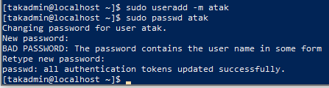
Create a new user - Optional
While ssh’d into your server do the following:
Create a new user named atak
sudo useradd –m atak
Set the password for the atak user
sudo passwd atak
Enter the password for the atak user
atakatak
It will ask you to enter it twice
If done correctly you should see the following:
Make atak user ‘sudo user’
sudo usermod –aG wheel atak
Switch from the Root user to the ATAK user
su – atak
Notes:
# Allows for a blank slate for the TAK Server

Slide 3
Copy over scripts
Download FileZilla
https://filezilla-project.org/download.php?platform=win64
Once opened:
The Local site is your development machines libraries.
The Remote site is where the libraries will be for the machine you remote into.
In the upper left select this icon:
Select “New site”
Protocol: SFTP
Host: <IP address>
User: takadmin
Password: atakatak
Select “Connect”

Slide 4
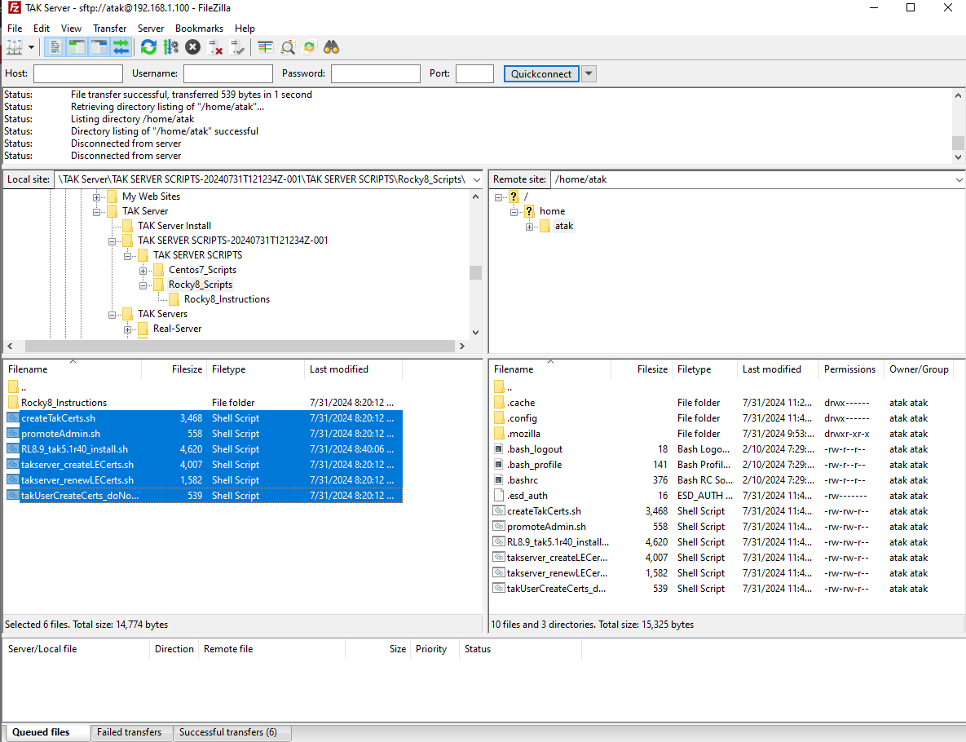
Transferring Scripts
In the Remote site panel navigate to the following:
home → (user)
In the Local site side navigate to the following:
TAK Server Scripts → Rocky_Scripts
From the Local site select the 6 shell scripts and drag and drop them into the (user) folder on the Remote site.

Slide 5
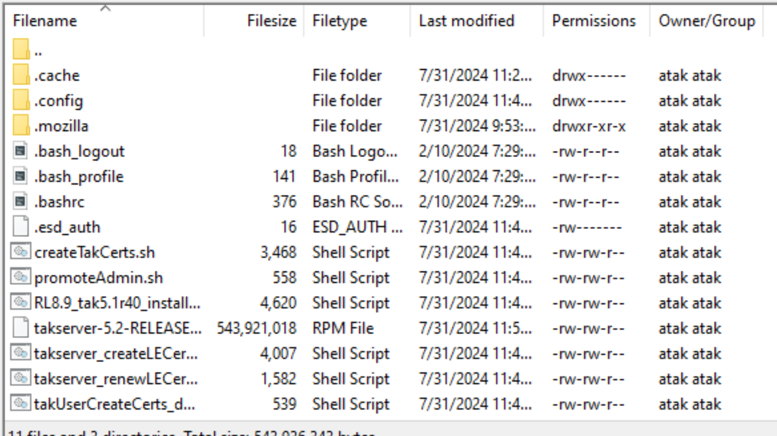
Transferring Install File
In FileZilla on the Local site panel navigate to the downloaded TAK Server installation file:
Drag and drop this file into the Remote site panel in the atak folder.
You can now minimize the FileZilla application.
The following should be the contents of your atak folder:

Slide 6
Install the TAK Server
Go to the user folder where the scripts and TAK Server rpm files are.
cd /home/takadmin
Queue up the TAK Server install
sudo chmod +x RL9.5_tak5.4r14_install.sh
Enter in the password for atak if prompted
atakatak
Execute the TAK Server installation
./RL9.5_tak5.4r14_install.sh
If when you try to run this command, it returns: “No such file or directory” run the following and then try the script again:
sed -i -e 's/\r$//' RL9.5_tak5.4r14_install.sh
Filters and transforms the text

Slide 7
TAK Server Install Prompts
Atak user password for installing Java 17: atakatak
Install 1 package: y
Select java option: 1
Enter the following with no Spaces (you can enter whatever you want)
STATE:
CITY:
ORGANIZATION:
ORGANIZATION UNIT:
Give a name for the Certificate Authority, has to be at least five characters: (anything you want (TAKSERVER))
Do you want me to move files around: y
Following this:
the server will restart for 90 seconds before it configures the intermediate-ca for use
The server will restart for 270 seconds to ensure the TAK Server is fully restarted prior to promoting the admin.pem certificate to the admin role.

Slide 8
TAK Server Configuration/Monitoring
To enable the server to automatically start when we restart the VM run the following:
sudo systemctl enable takserver.service
To start the server from the command line:
sudo systemctl start takserver.service
To make sure the server is running:
ls -l /opt/tak/logs/
In here we want to make sure the takserver-messaging.log file is created.
tail -f /opt/tak/logs/takserver-messaging.log
Streams the end of the log to allow us to verify the server is running properly
Main things we are looking for:
INFO c.b.marti.nio.netty.NioNettyBuilder - Successfully Started Netty Server for TlsServerInitializer on Port 8089 with watermark WriteBufferWaterMark(low: 2048, high: 4096)
This lets us know that the client-to-server listener is started and is accepting clients
INFO com.bbn.marti.nio.server.NioServer - Server started
This tells us the services have started
INFO com.bbn.marti.util.VersionBean - TAK Server version 5.0-RELEASE-29-HEAD
This lets me know what version is running and that all services have started

Slide 9
Initial Configuration
If using a different username than atak:
Change the directory to the Linux home directory
cd ~
Copy the admin cert to our home directory
sudo cp -v /opt/tak/certs/files/admin.p12 .
Copy the truststore cert to our home directory
sudo cp -v /opt/tak/certs/files/truststore-intermediate-ca.p12 .
Change the ownership to our Linux user
sudo chown -R <username>:<usergroup> /home/<username>
Example: sudo chown -R takadmin:takadmin /home/takadmin
If you don’t do this, you can’t copy the files from the server to your development machine.
You can us “ls” to verify that the file is in the right place .
Notes:
# Now that we have created the admin cert we need to move it so that we can copy and install it on our admin workstation remotely.
# Remember to add the period at the end of the command when moving the cert to move it to the current location

Slide 10

Retrieve Admin Certificate
Open FireZilla
Local site: Downloads
Remote Site: /home/takadmin
Locate the “admin.p12” file and the file “trustore-intermediate-ca.p12” in the Remote site panel
If you’d like to change the name of the file you can
Drag and drop the files into the Local site panel Downloads folder.
You can create a folder called “Certificates” to keep track of the user certificates.
If the permissions are denied:
Enter the root user: sudo su root
Navigate to the file location: cd /opt/tak/certs/files
Changed permissions: chmod ugo+rwx <filename>

Slide 11
Importing User Certificate
Windows:
Double click on the user certificate, which will open the windows certificate import wizard.
Store Location: Current User
File path should be correct
Password: atakatak
Certificate Store: Automatically select the certificate store based on the type of certificate
Select “Finish”
Select “Yes” for the security warning
Import should be successful

Slide 12
Fire Fox Certificate Import
Open Fire Fox and navigate to its settings
Search for “cert”
Select “View Certificates”
Ensure you are on the “Your Certificates” panel
Select “Import”
Navigate to where we copied over the “admin.p12” file and select it.
You will be prompted for the password: atakatak
Once imported you can select “OK” to close the certificate manager.

Slide 13
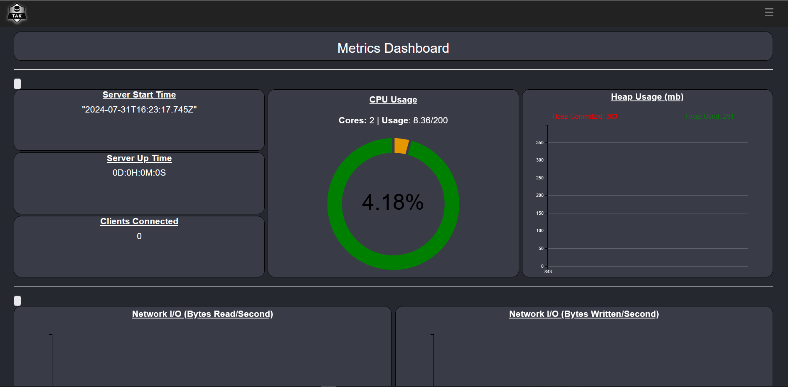
Connect to your TAK Server
To connect to your TAK Server dashboard, open a your browser.
Type the following:
https://<IP address>:8443
Follow the prompts.
You are now at your TAK Server dashboard.

Slide 14
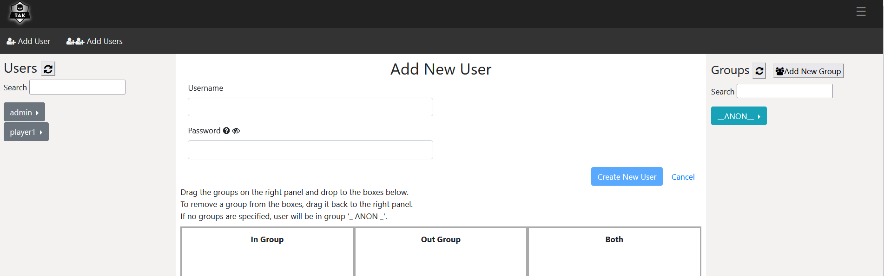
Connect to your TAK Server – WebTAK
To connect to the server as a user:
From the server dashboard select the hamburger menu at the top right.
Select “Administrative”
Select “Manager Users”
At the top left select “Add User”
Username: <enter username here>
Password: <enter password here>
Select “Create New User”
Open a browser
Type: https://<IP address>:8446
Sign in as the user you just created
Notes:
Adding multiple users will create a text document that will contain the users passwords.

Slide 15
Methods of Connecting to TAK Server
Option 1 - Create Data Package for Connection
The easiest way to get the client onto the server is to create a Data Package (a zipped file) with the truststore-intermediate-ca.p12 file, a manifest and a preference file with the web address.
When you downloaded the MASTER_SERVER_NAME_FOLDER_STRUCTURE it came with a boiler plate profile preference file and a manifest you can modify to reflect this information.
Once the data package is created you can share that out with the user’s unique username and password you created using the TAK-Server GUI.
The end user will download the data package onto their device, use the import feature in the TAK device, upon import the TAK device will prompt for the username and password.
Option 2 - Manual cert enrolment
The second option is the TAK client can add a connection manually and enroll for a certificate.
To do that share the web address of the server i.e. tak1.mytakserver.com and the username and password you created on the TAK Server web GUI.
From the TAK device the user can add the TAK Server connection using the domain address and then choose enroll for certificate and then at prompt enter the username and password combo you issued to them.

Slide 16
Creating Data Packages
Open file explorer to Master_SERVER_... → Auto Enrollment Data Package
Copy the “truststore-immediate-ca.p12” file over to the Auto Enrollment Data Package folder
In the Auto Enroll Data Package folder open the “config” file with a text editor
Where it says: “TAKSERVER_NAME_GOES_HERE” remove this and put what you want your server to say (TAK-Server)
Where it says: “ipaddress_or_FQDN_goes_here” remove this and put your server IP address. Do not remove :8089:ssl
Save the document and close it

Slide 17
Creating Data Packages
In the Auto Enroll Data Package open the MANIFEST folder
Open the manifest file with a text editor
Where it says “Renameit_Server” replace it with what you want to name your data package (TAK-Server)
Save the file and close the text editor
We now want to zip the contents in the Auto Enroll Data Package folder.
Select all the files ( hold ctrl + click all the files desired)
Right click
Select “Send to”
Select “Compressed (zipped) folder”
If the zipped folder does not match the name set in the manifest file, select the zipped folder and rename it.

Slide 18
Connecting to your TAK Server – Data Package ATAK
After creating the data package send it to the device you want to import it on.
Via: Email, Google Drive, OneDrive, etc.
Download the zip file onto that device.
ATAK:
Open ATAK.
Select the hamburger menu in the top right of the screen.
Scroll down and select import.
Select Local SD.
Select Date to sort the files by date modified.
Select the data package zip file you downloaded.
Select OK
Enter credentials for the server
Note the credentials are that which you created on the server already.
If all done correctly you should see a message saying you connected successfully

Slide 19
Connecting to your TAK Server – Data Package WinTAK
If you are not intending to use your current device to run WinTAK
After creating the data package send it to the device you want to import it on.
Via: Email, Google Drive, OneDrive, etc.
Download the zip file onto that device.
Open WinTAK
You can drag and drop the zip file into WinTAK.
It will then ask you for the server credentials.
Enter credentials for the server
Note the credentials are that which you created on the server already.
If done correctly it should tell you it has connected.
You can always use the import manager accessible from the WinTAK hamburger menu in the top left of the application.

Slide 20
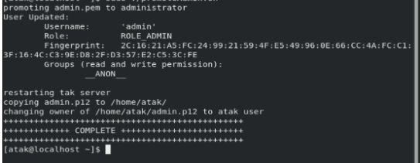
Server login issues
If you run into the issue where you can't login to the admin portal and are being forced to the webtak login page at port 8446 run the commands below.
cd /home/atak
sudo chmod +x promoteAdmin.sh
atakatak
sudo ./promoteAdmin.sh

